Slide 1
The Stargaze App Case Study
Brian Thompson

Slide 2
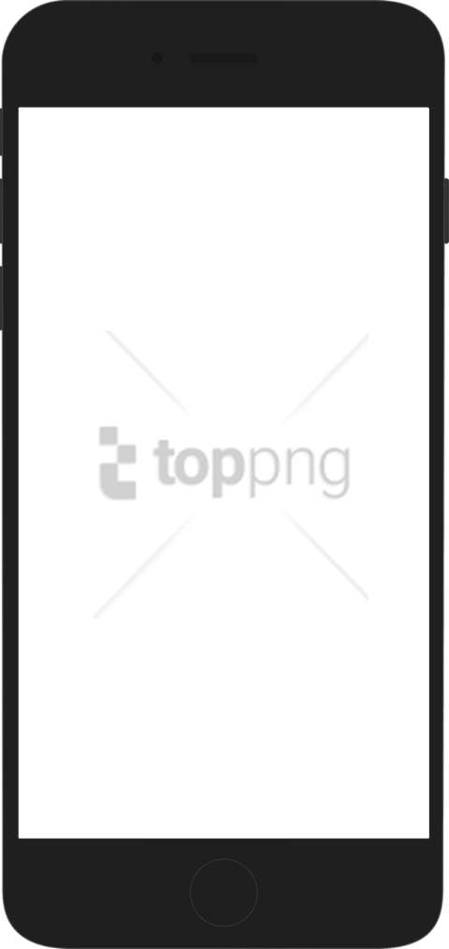
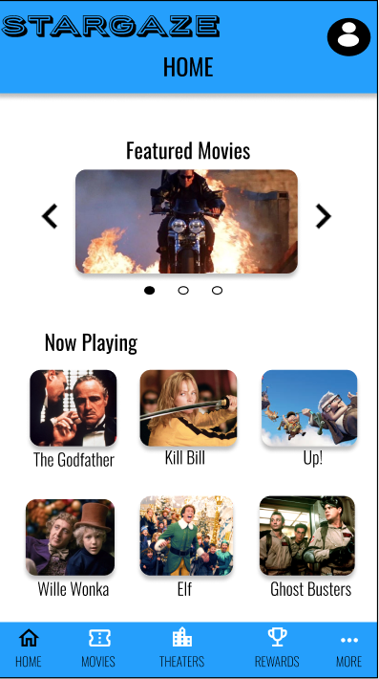
Project overview
The product:
The Stargaze app is a app that allows users to purchase movie tickets, food, and drinks in advance before they arrive at the movie theater of their choosing, hassle free.
Preview of selected polished designs.
Project duration:
November 2021 – December 2021

Slide 3
Project overview
The problem:
In this project we wanted to solve the challenge of ordering movie tickets online for users.
The goal: I want to understand the processes, challenges and emotions that people experience around using a mobile ticketing app before, during, and after the movie experience

Slide 4
Project overview
My role:
UX designer, UX researcher from conception to delivery
Responsibilities:
User research, ideation, wireframing, prototyping, and mockups

Slide 5
User research
Personas
Problem statements
User journey maps
Understanding
the user

Slide 6
User research: summary
The usability studies that were included in the research were both unmoderated, conducted in the United States, and lasted a total of 60 minutes over a course of two days. 5 Participants were included in each study. Participants varied from ages 16-50, male/female/non-binary, and vision-impaired. The goal of the studies was to figure out if users can complete the core tasks within the app such as ordering movie tickets. We’re creating a new app to help people purchase movie tickets hassle free. Before launching we need to figure out if getting tickets through our app is easy for users to do. We’d like to understand what specific challenges our users might face in the ordering, process and how we can help them fix those challenges.

Slide 7
User research: pain points
1
2
3
Convenience
Age Rating of Movies
Viewing Selection
It is not convenient to order movie tickets for yourself or for others at a movie theater. Users want a way to do this before they go to have things prepared and an effective way to do it that is easy.
Users with a family or age concerns want to be able to know what movie they will be able to watch.
Users need to be able to see the movie when, where, and how they want to see it. This means being able to chose the theater, viewing experience (ex: Imax, 3D, etc.), and time and date.

Slide 8
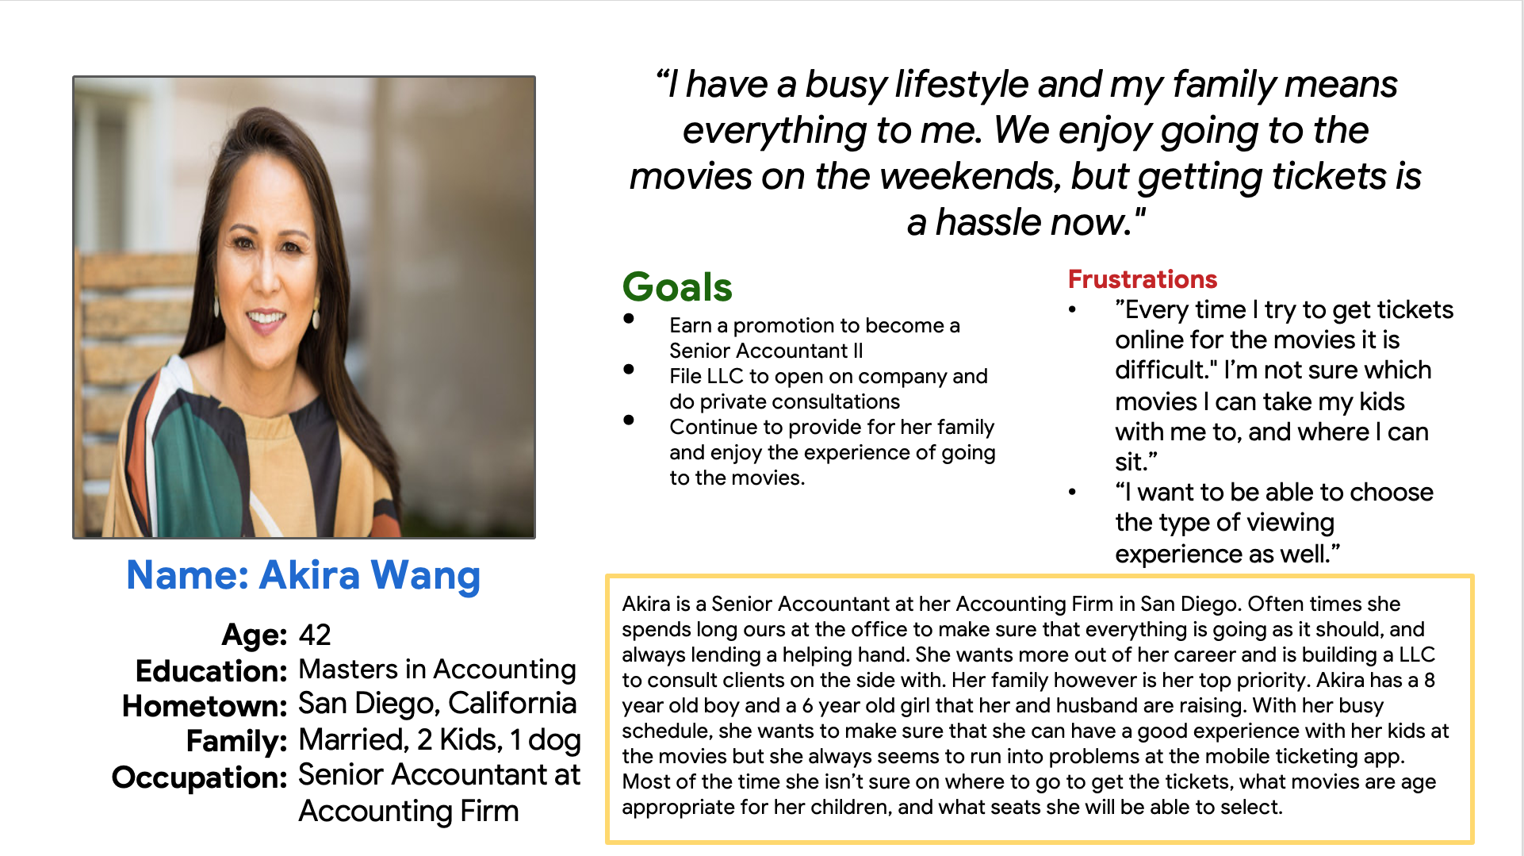
Persona: Akira Wang
Problem statement:
Akira is a senior account and mother who needs to be able to order movie tickets online easily for her family in advance with a convenient experience so that she can enjoy going to the movies with her family.

Slide 9
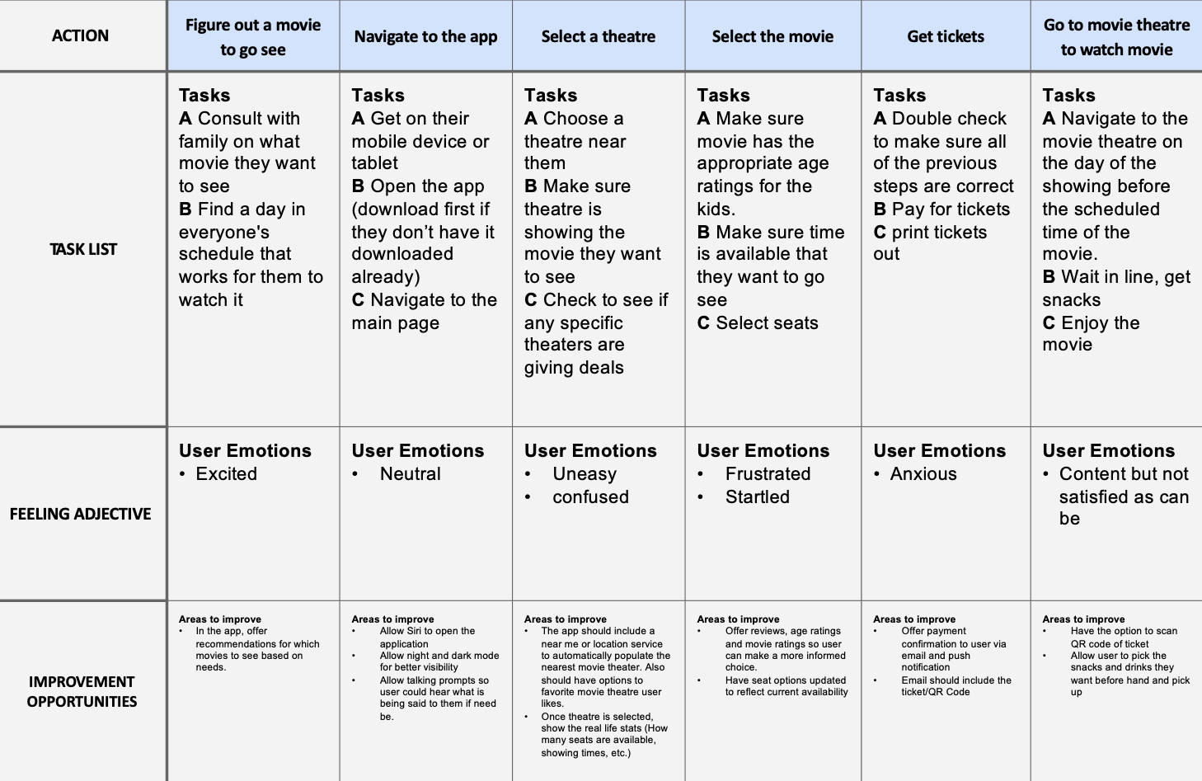
User journey map
Taking users through a typical way to navigate through an app to purchase movie tickets.
Image of user journey map

Slide 10
Paper wireframes
Digital wireframes
Low-fidelity prototype
Usability studies
Starting
the design

Slide 11
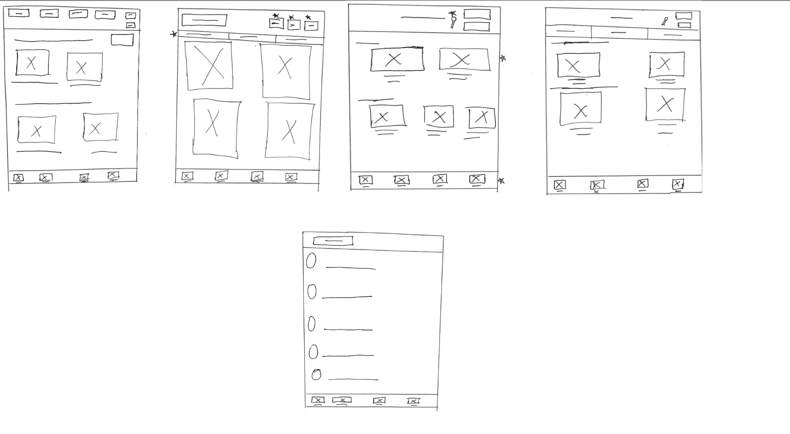
Paper wireframes
These paper wireframes represent key elements and components that would be considered for the homepage of the Stargaze App.
Image of paper wireframes including five different versions of the same screen and one image of the new, refined version

Slide 12
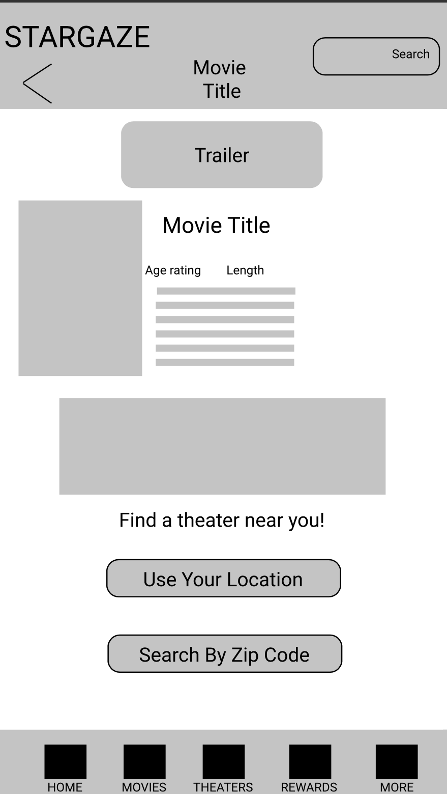
Digital wireframes
Icon where users can view a trailer of the selected movie
Description of age rating, and length of movie
The goal of this wireframe is for the user to see all the information on the movie they have selected that they would like to watch and to prompt them to select a theater they would like to watch the movie.
Picture of the movie
Buttons users can use to select the location of the theater by zip code or their location

Slide 13
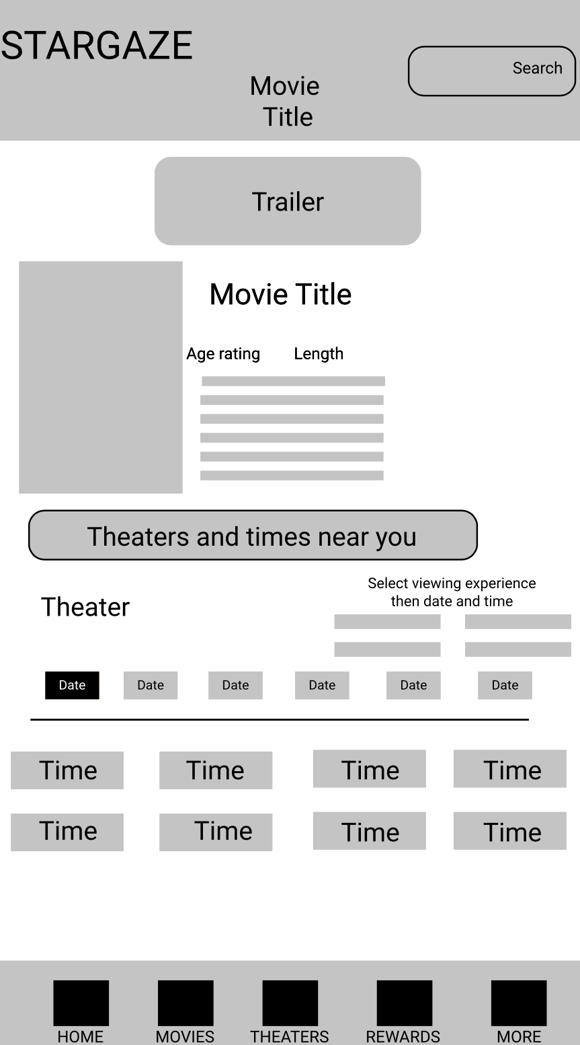
Digital wireframes
Trailer of movie that will show a preview of the movie
Title of movie selected
A wireframe detailing how a user can select a theater to view the movie that they have selected and a brief overview of the movie they have selected.
Description of Age Rating, and Length of movie
Heading to prompt user to select a theater
Description of Viewing experience, date, and time

Slide 14
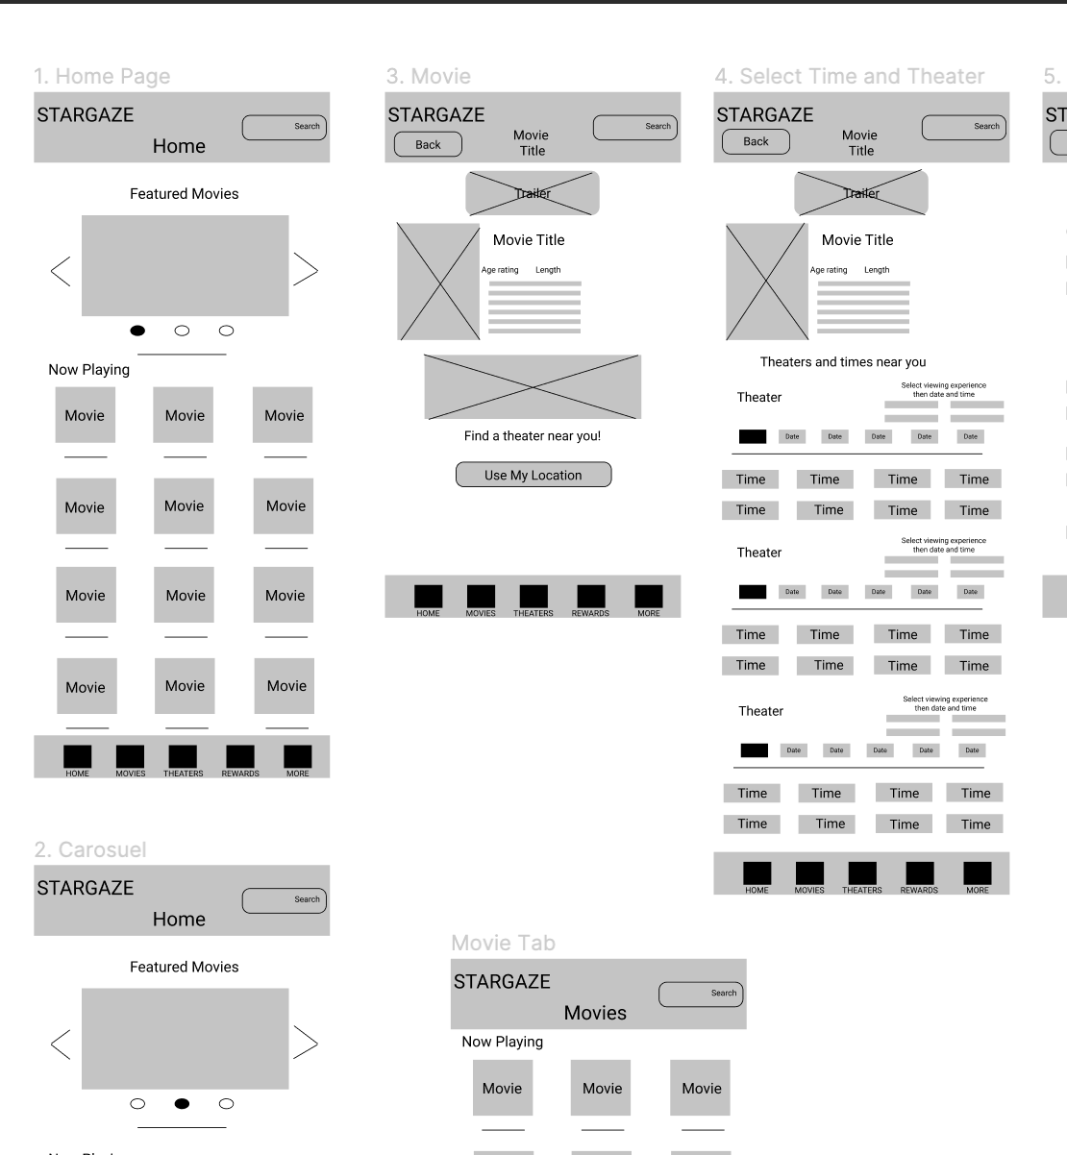
Low-fidelity prototype
Link to low-fidelity prototype here
Screenshot of prototype with connections or prototype GIF

Slide 15
Usability study: findings
Here are a few insights that we have found from both usability studies. These are the findings that we found most prominent and will effect the user experience the most.
Round 1 findings
Round 2 findings
1
3 out of 5 participants had difficulties selecting their location for a movie theater. This means that the location page needs to be refined to make it easier for people to choose their location and theater.
1
3 out of 5 participants wanted a movie rating of the movie they selected. This means that a rating system or page needs to be created to show users how others liked or disliked this movie.
3 out of 5 participants thought they needed to click the select your seats icon to pick their seats. This means that this needs to be redesigned to not look like a button, and more clear directions are needed for users to pick their seats.
3 out of 5 participants wanted to see a map of the locations of the theater in addition to how far away the theater was from them. This means that the theater page needs to be redesigned to have a feature where they can see a snippet of google maps and the mileage of the theater.
2
2
3
3 out of 5 participants wanted a page to see their account info. This means that there should be an account page where the user could get to this information.
3
3 out of 5 participants weren’t sure where to login to access their account. This means that a profile icon needs to be established so that it is clear to users where they need to go to access their profile info.

Slide 16
Usability study: findings
Here are a few insights that we have found from both usability studies. These are the findings that we found most prominent and will effect the user experience the most.
Round 1 findings
Round 2 findings
1
3 out of 5 participants had difficulties selecting their location for a movie theater. This means that the location page needs to be refined to make it easier for people to choose their location and theater.
1
3 out of 5 participants wanted a movie rating of the movie they selected. This means that a rating system or page needs to be created to show users how others liked or disliked this movie.
3 out of 5 participants thought they needed to click the select your seats icon to pick their seats. This means that this needs to be redesigned to not look like a button, and more clear directions are needed for users to pick their seats.
3 out of 5 participants wanted to see a map of the locations of the theater in addition to how far away the theater was from them. This means that the theater page needs to be redesigned to have a feature where they can see a snippet of google maps and the mileage of the theater.
2
2
3
3 out of 5 participants wanted a page to see their account info. This means that there should be an account page where the user could get to this information.
3
3 out of 5 participants weren’t sure where to login to access their account. This means that a profile icon needs to be established so that it is clear to users where they need to go to access their profile info.

Slide 17
Refining
the design
Mockups
High-fidelity prototype
Accessibility

Slide 18
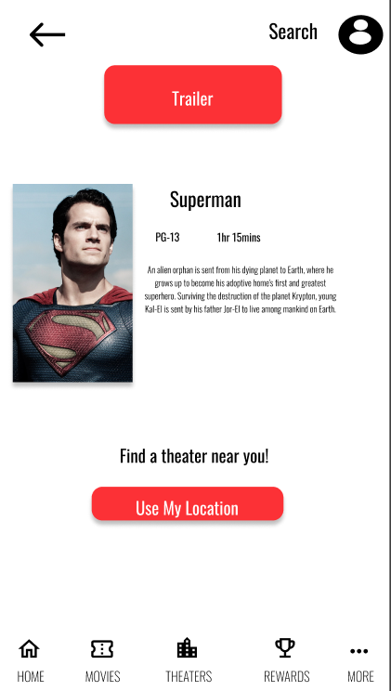
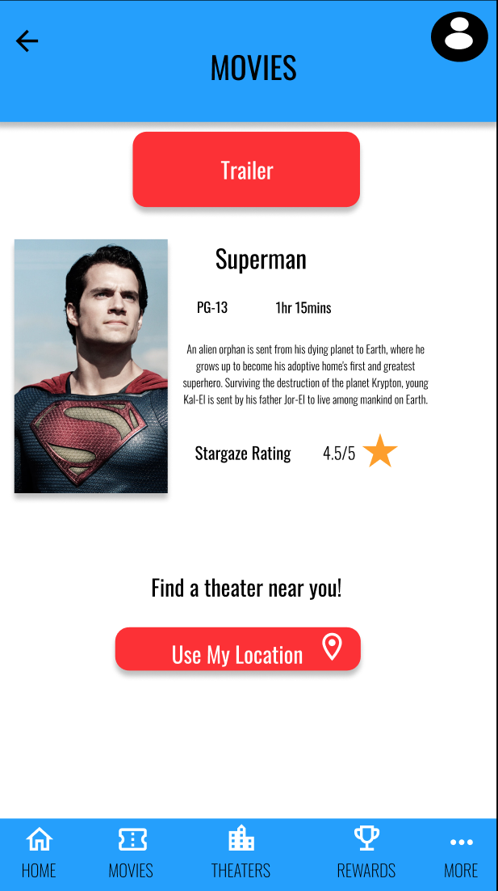
Before usability study
After usability study
Mockups
Image of selected screen after usability study

Slide 19
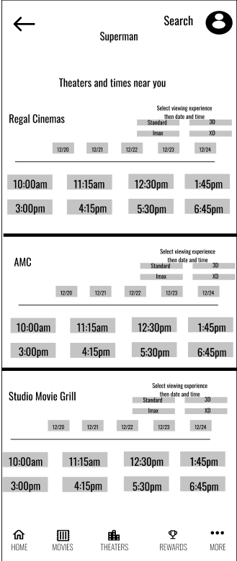
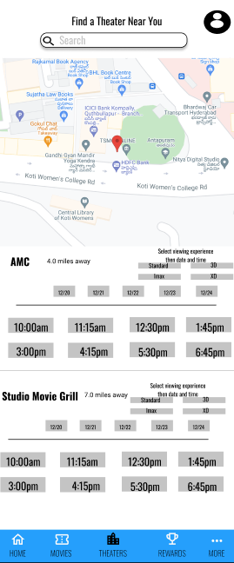
Before usability study
After usability study
Mockups
Image of selected screen before usability study
Image of selected screen after usability study

Slide 20
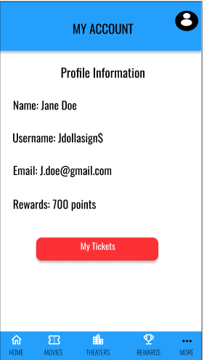
Before usability study
After usability study
Mockups
NONE
Image of selected screen after usability study

Slide 21
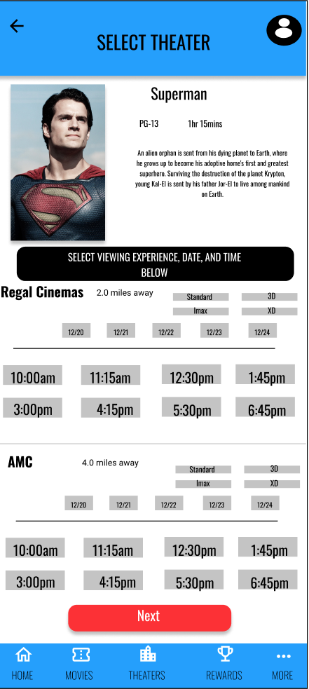
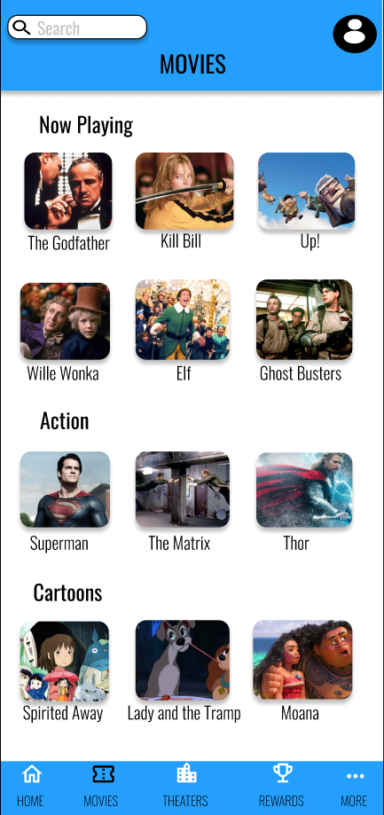
Mockups
Main mockup screen for display
Main mockup screen for display
Main mockup screen for display
Main mockup screen for display

Slide 22
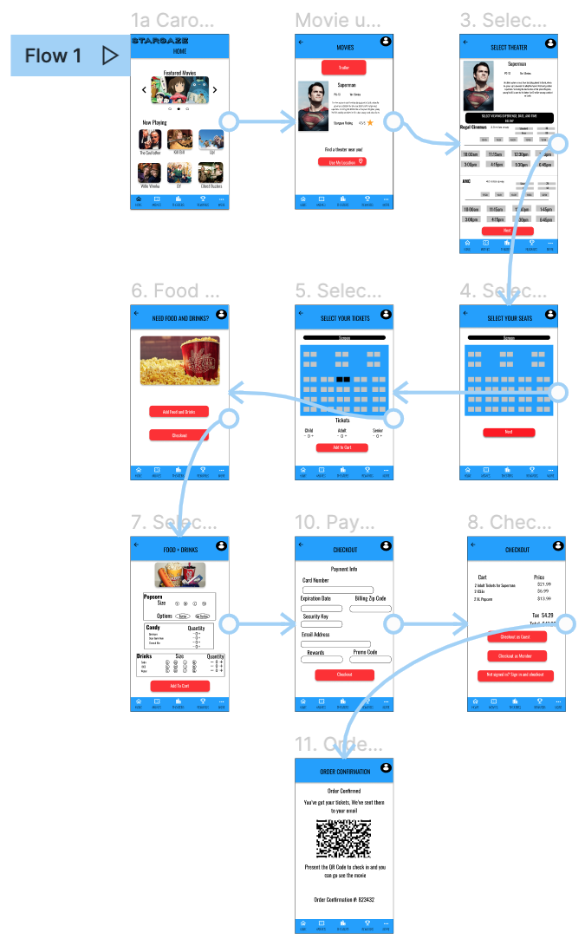
High-fidelity prototype
Link to high-fidelity prototype here
Screenshot of prototype with connections or prototype GIF

Slide 23
Accessibility considerations
1
2
3
The typeface overall of the app was used in a way that will allow for those that are visually impaired to easily navigate the page. A screen reader can also be used for the app as well.
The color palette was chosen that was used in the app was designed to have high contrast for easy readability.
Users have the ability to select their preferred language in the more section of the app and the app will be translated into that language.

Slide 24
Going forward
Takeaways
Next steps

Slide 25
Takeaways
Impact:
The app is user friendly and gets users excited about going to the movies again.
A quote from peer feedback:
”This app is AWESOME. I can’t wait to use it to order movie tickets so me and my family can go see a movie.”
What I learned:
The user is king and that’s how it should be. Every step of the way you have to keep the user in mind as they will be using your product.

Slide 26
Next steps
1
2
3
Create code and develop mobile app
Conduct a usability study with the mobile app and perform user testing
Iterate the app from the study, and launch app

Slide 27
Insert a few sentences summarizing the next steps you would take with this project and why. Feel free to organize next steps in a bullet point list.
Let’s connect!
I’d love to connect with other UX designers and researchers and I am open to even collaborating on projects!
Contact Info:
Email: brianthompson072@gmail.com

Slide 28
Thank you!

